Slide 1


Project’s presentation

Slide 2
Table of contents
Our team
Our goal
01
02
03
Stages of realization
04
Used technologies

Slide 3
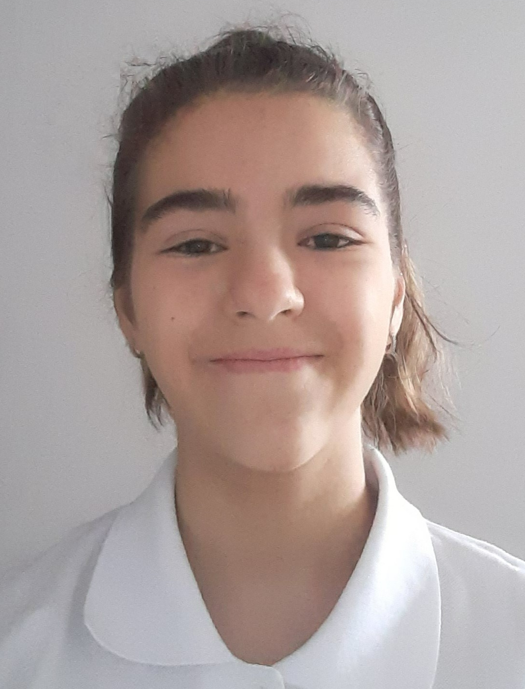
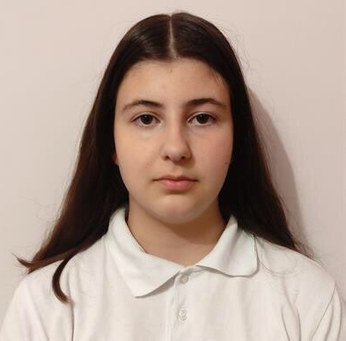
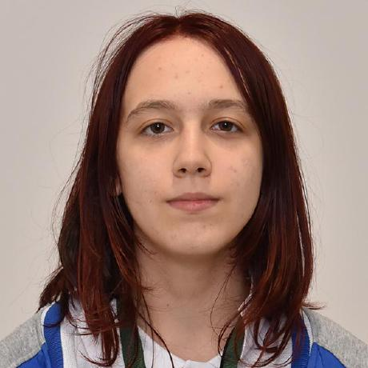
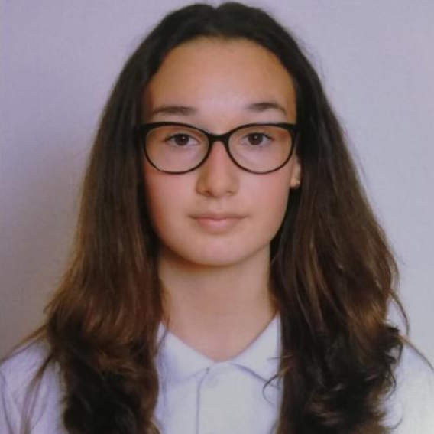
Our team
Nadezhda Ivanova
Valeria Chavdarova
Antonia Taneva
Viktoria Kupenova
Scrum Trainer
Back-End developer
Back-End developer
Back-End developer

Slide 4
Our goal
The main goal of a digital will is to ensure that your digital assets are properly handled and transferred according to your wishes.

Slide 5
Stages of realisation
Organization
Decide on the idea
Development
Presentation

Slide 6












Used Technologies

Slide 7

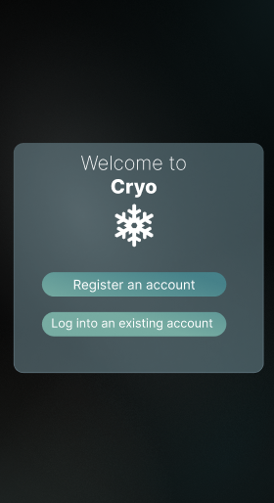

Slide 8

Thank you for your attention!

